Slide 1

Generative AI as a Translation Technology
Jacob Forward
King’s College, Cambridge
jf743@cam.ac.uk

Slide 2
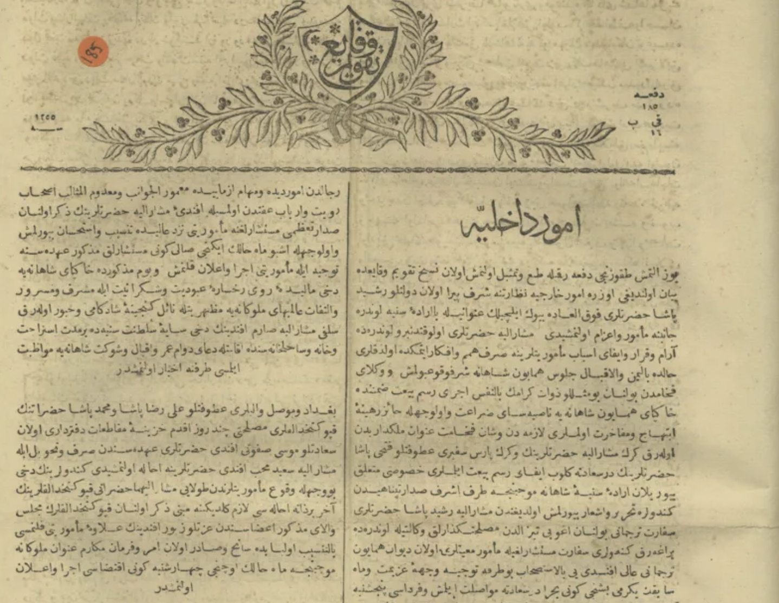

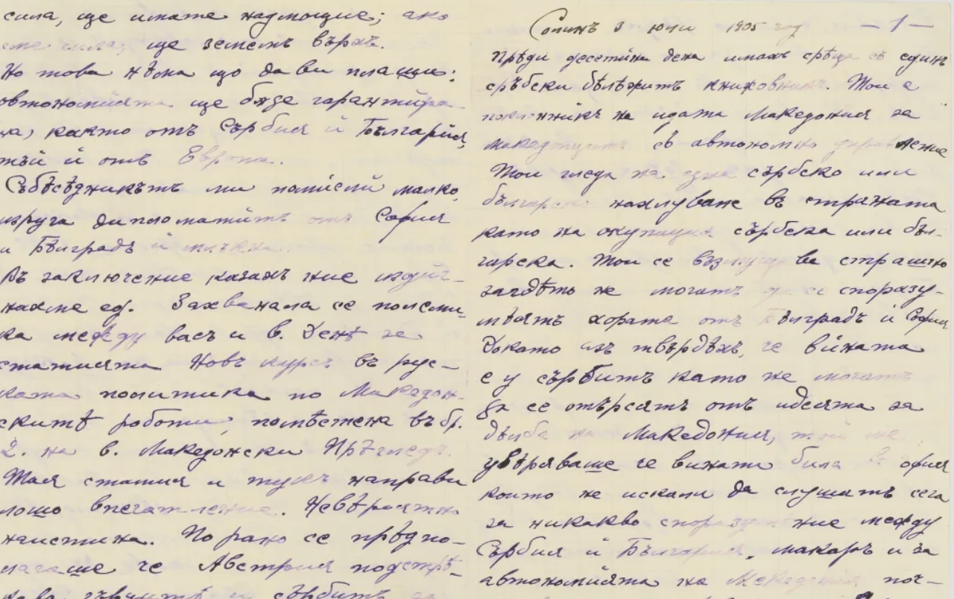
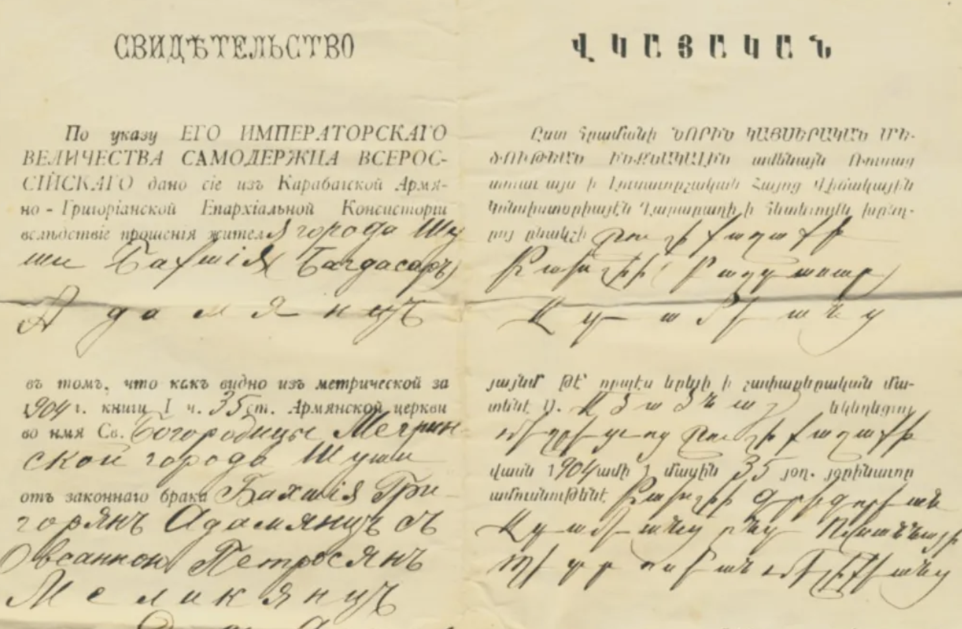
Transliteration and Translation of Historical Texts
- Ottoman Turkish, Albanian, Bulgarian, Greek, Armenian, and mid-20th Century Yiddish.
-Right-to-left texts, mix of hand-written and print, non-Roman alphabets.
-Accuracy? Reliability?
-Democratisation of access vs skills cost.
Colin Greenstreet
Substack: @generativelives

Slide 3
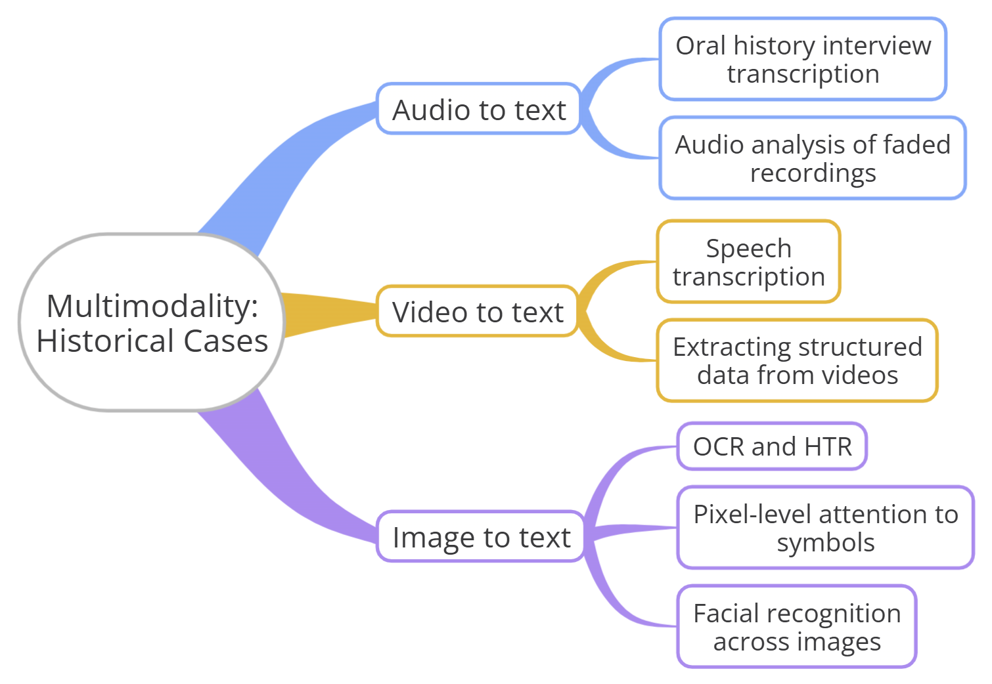
Multimodality: Historical Cases

Slide 4
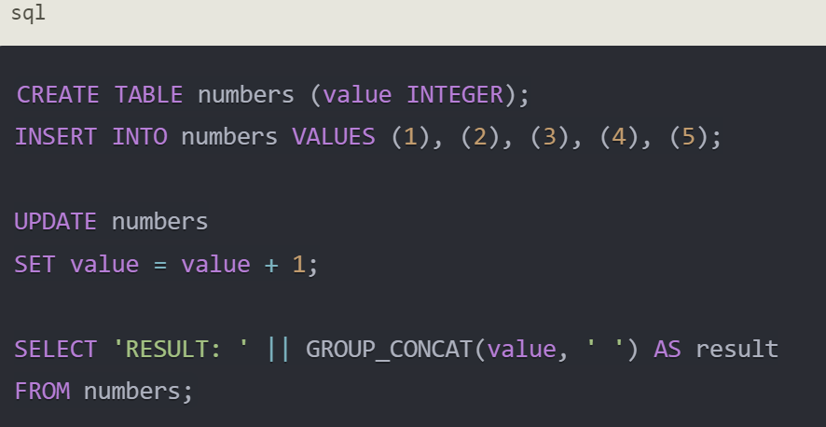
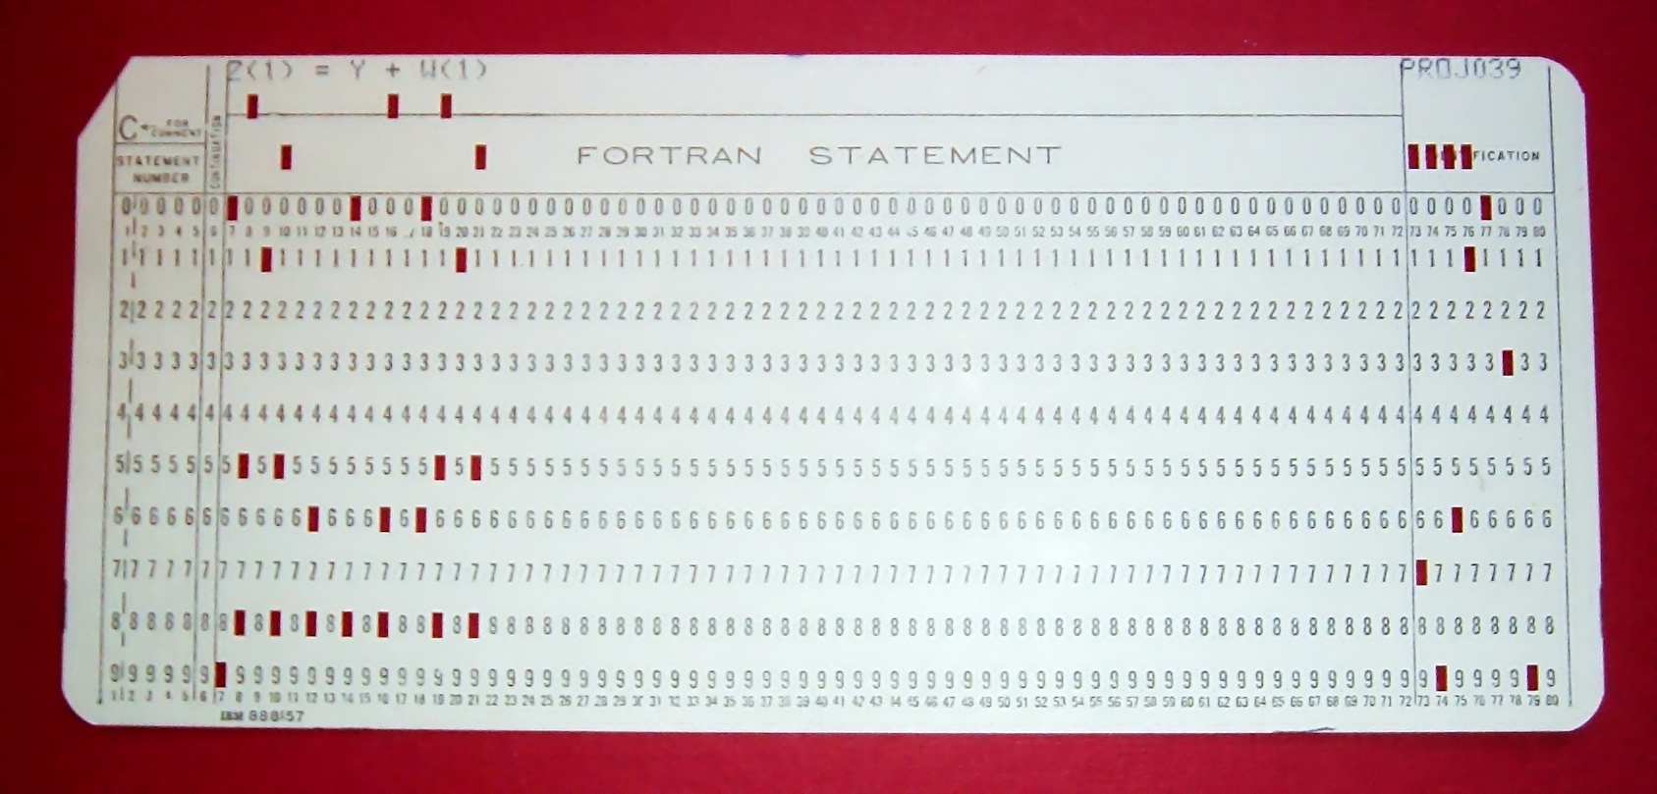
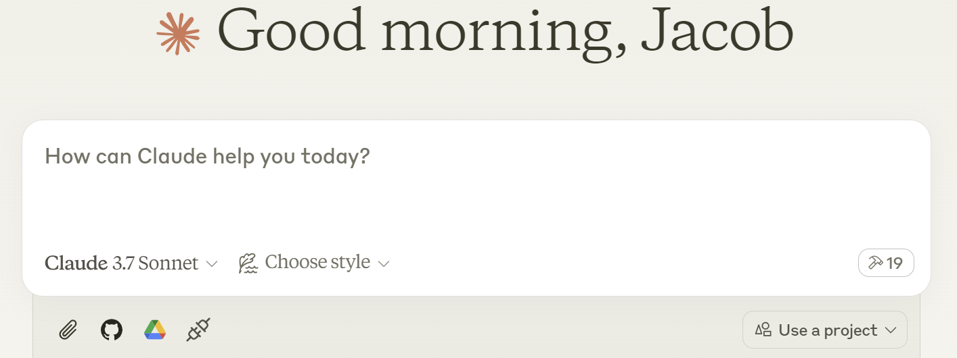

Human Languages to Machine Languages
Programming:
WW2
Present Day
Punch-card Programming
Programming languages
Human language
Search is being transformed:
-Human language questions
-Semantic search using embedding models and vector databases
-Or question to regex code/ or SQL for databases.
What if you had 24/7 access to your own dedicated research software engineer?

Slide 5
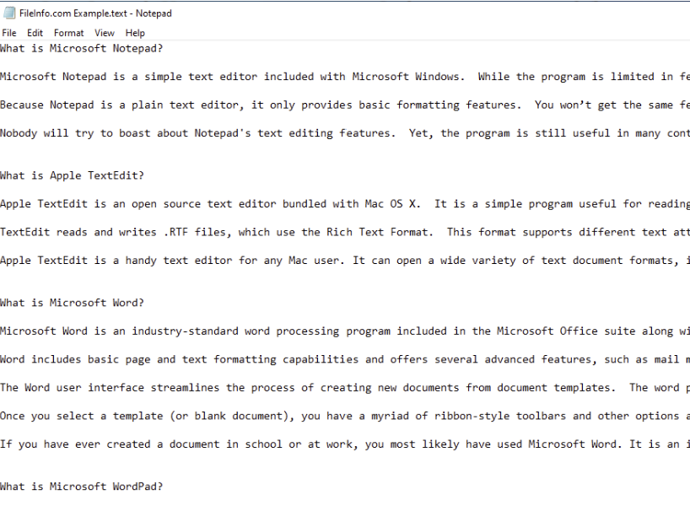
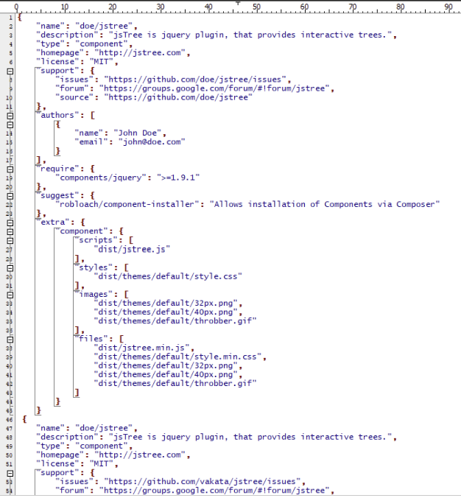

Unstructured to Structured Data
“The datafication of sources”
Raw historical sources
Digital full-text files
TEI, JSON, etc
structured universally readable file
Database
Digitisation
Processing
Storage
OCR, HTR, transcription
Translation, entity recognition, sentiment analysis, meta-data extraction
Database migration

Slide 6
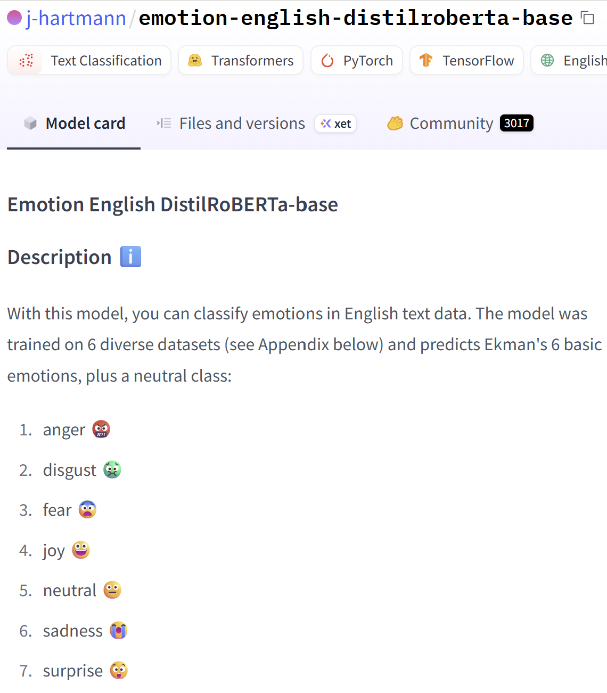
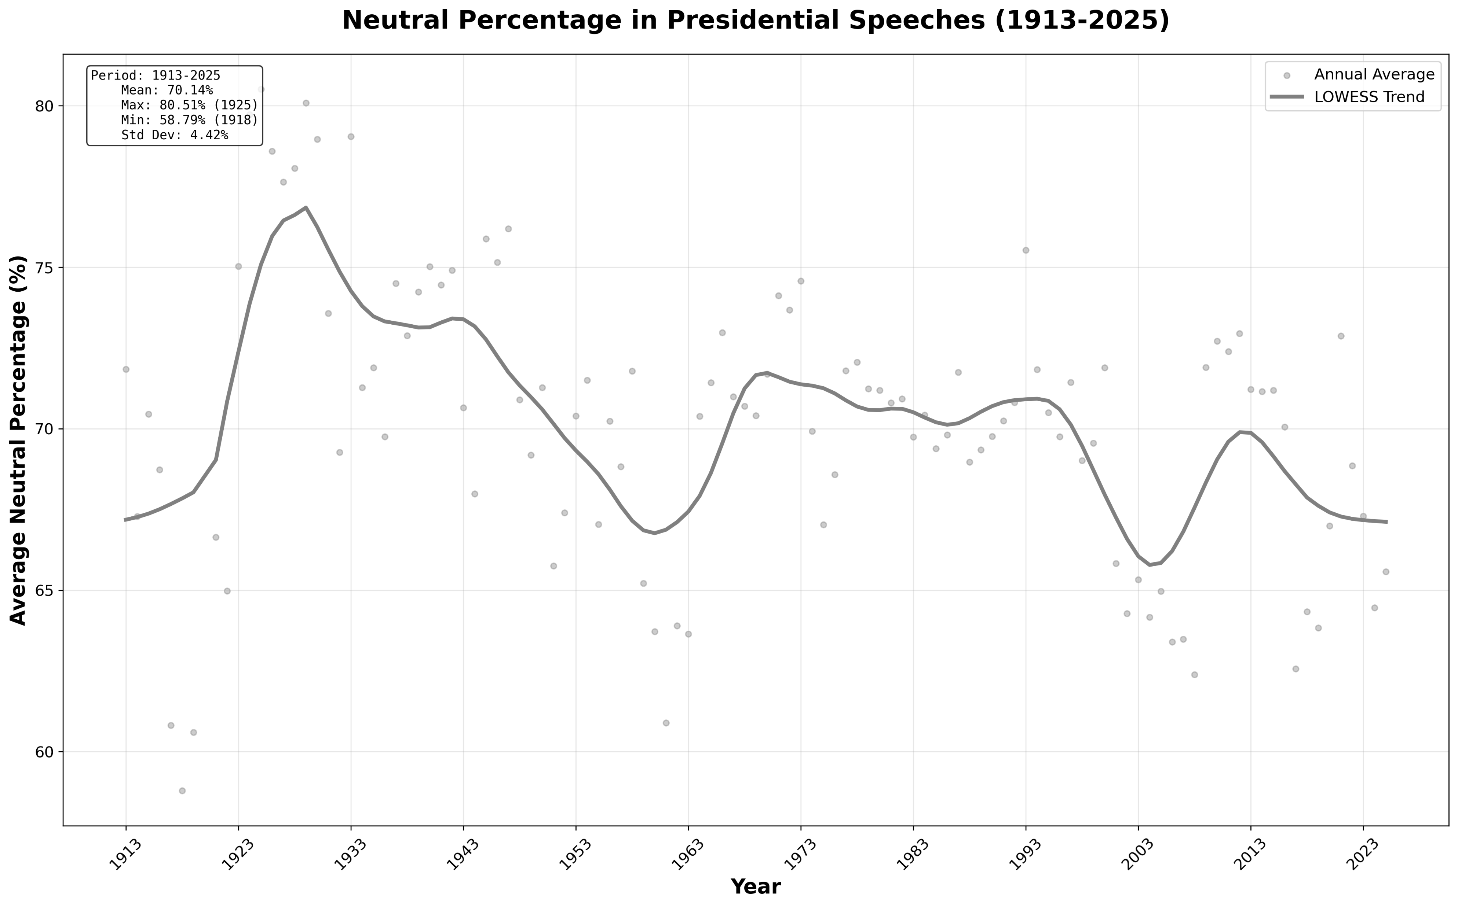
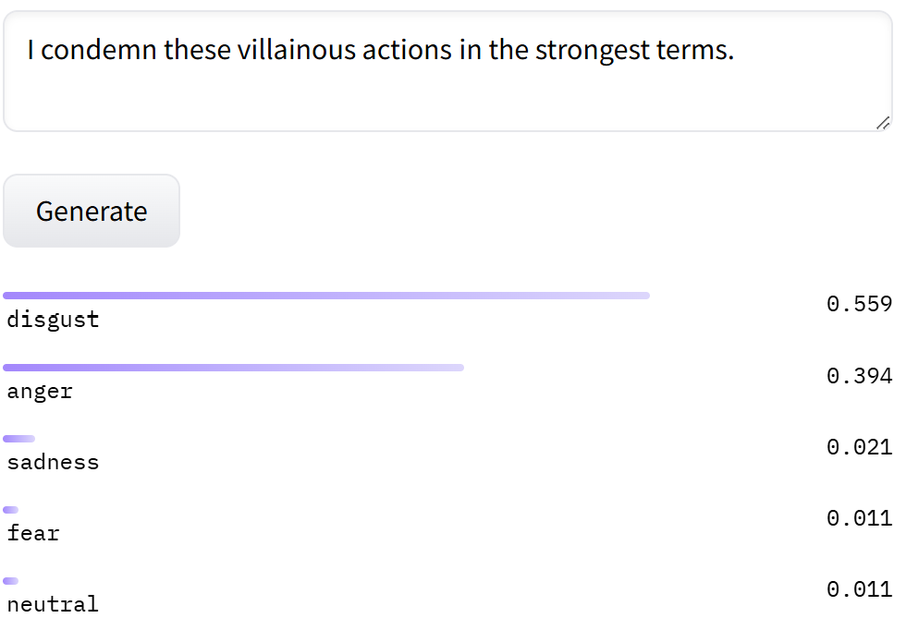
Example processing step:
Emotion Classification Models

Slide 7
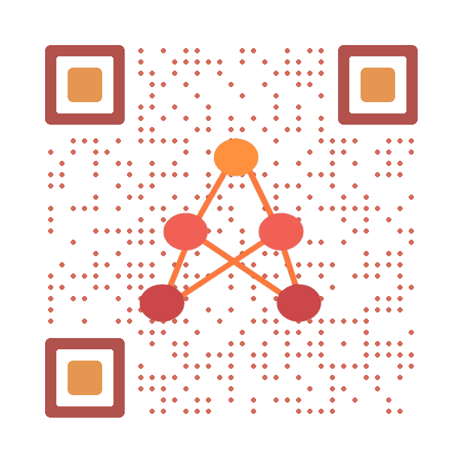
Thank you!
Jacob Forward
jf743@cam.ac.uk

